Slide 1



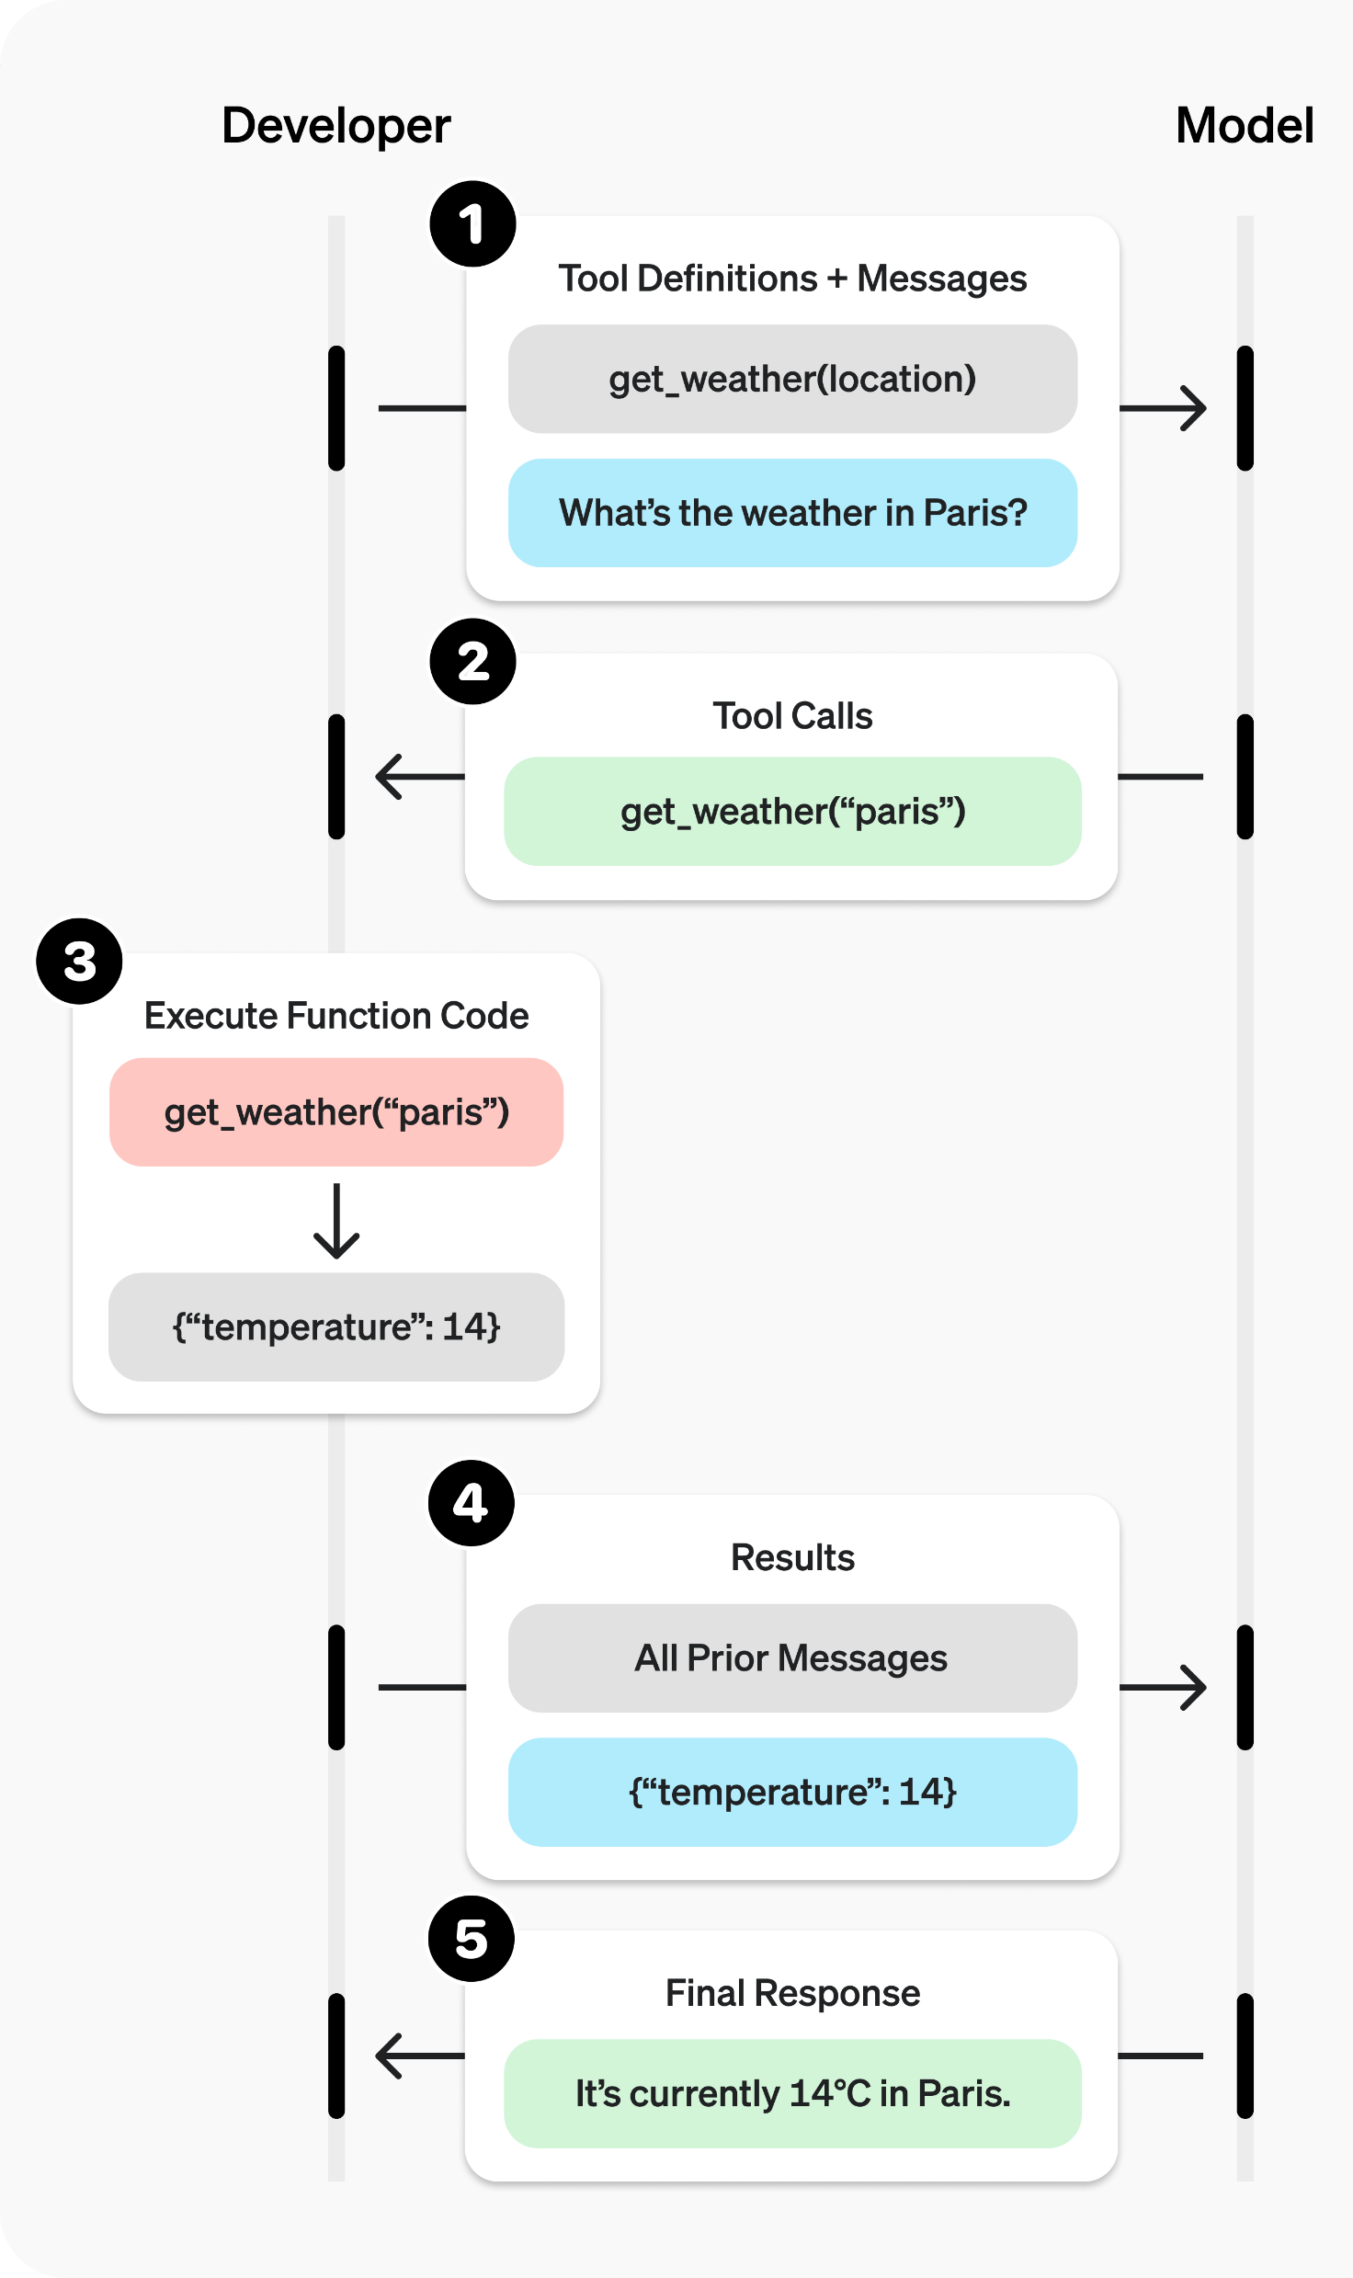




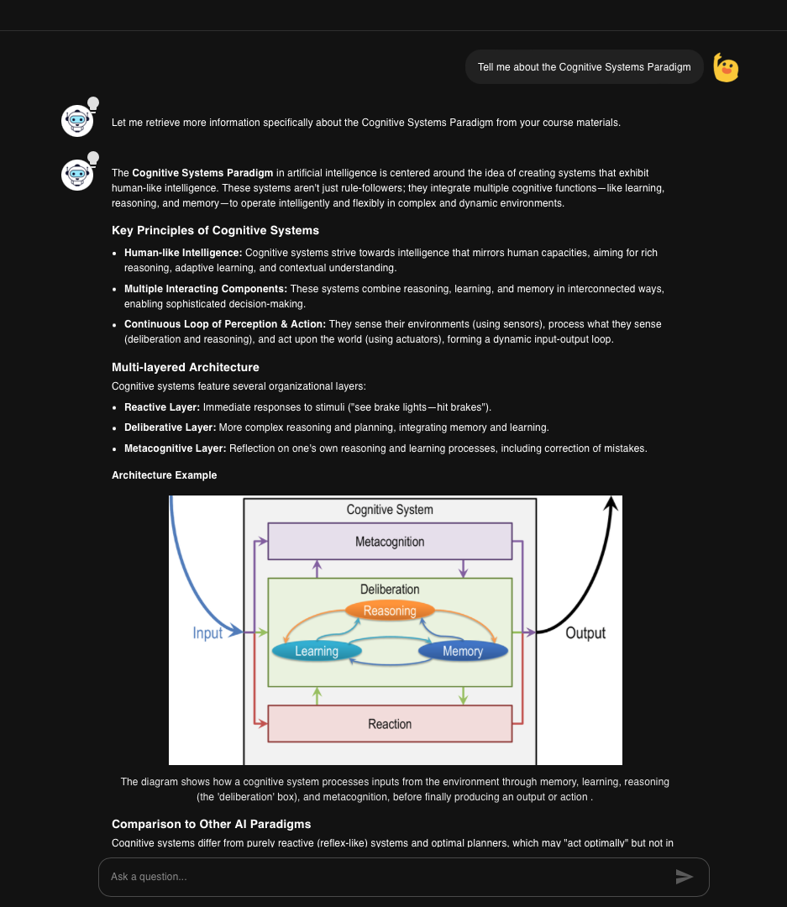
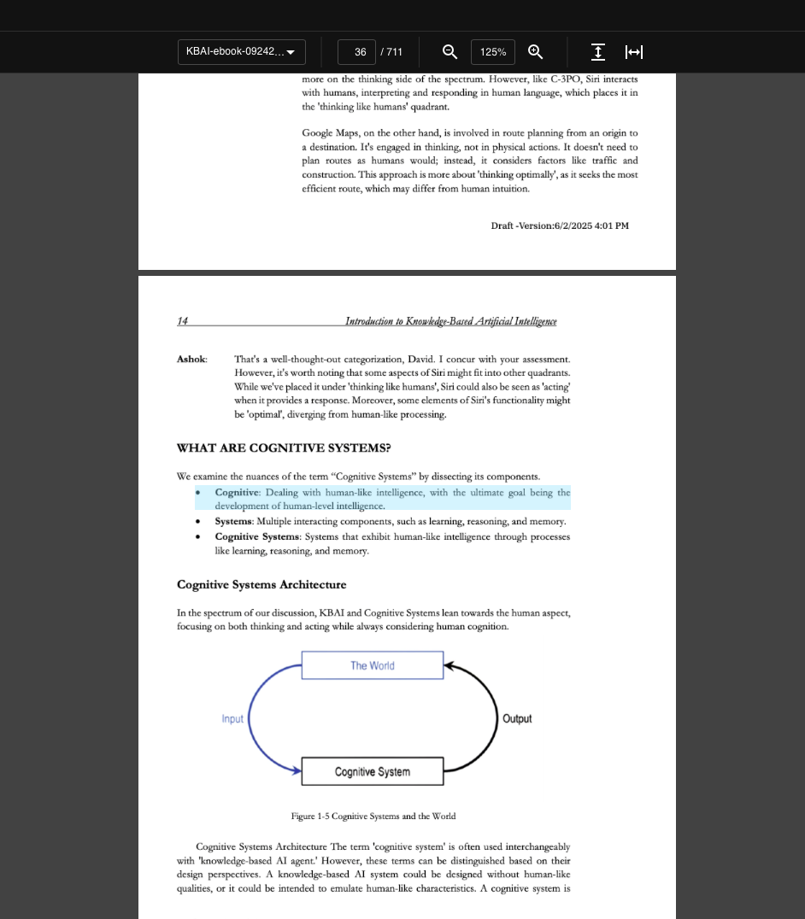





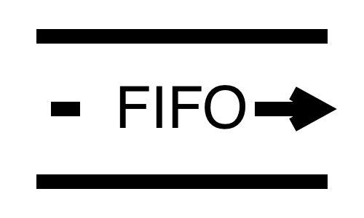







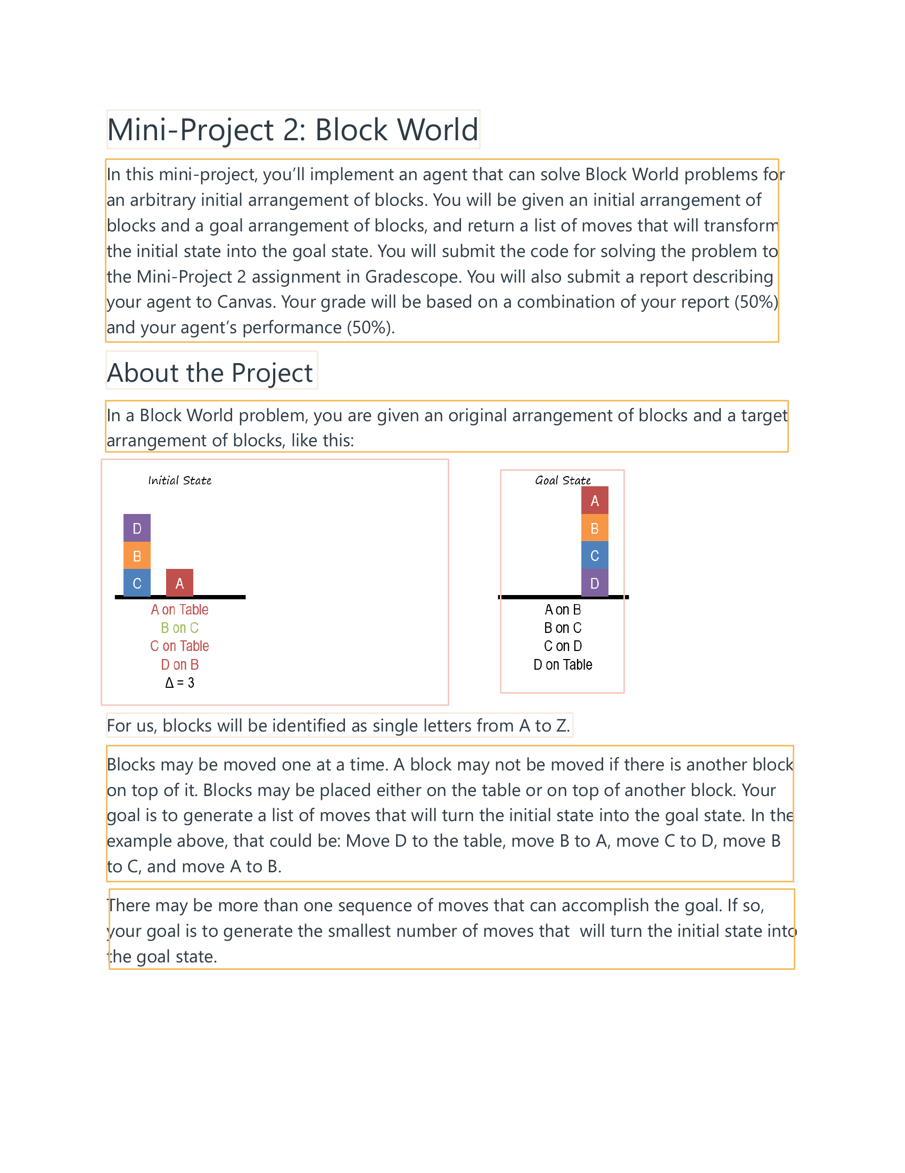

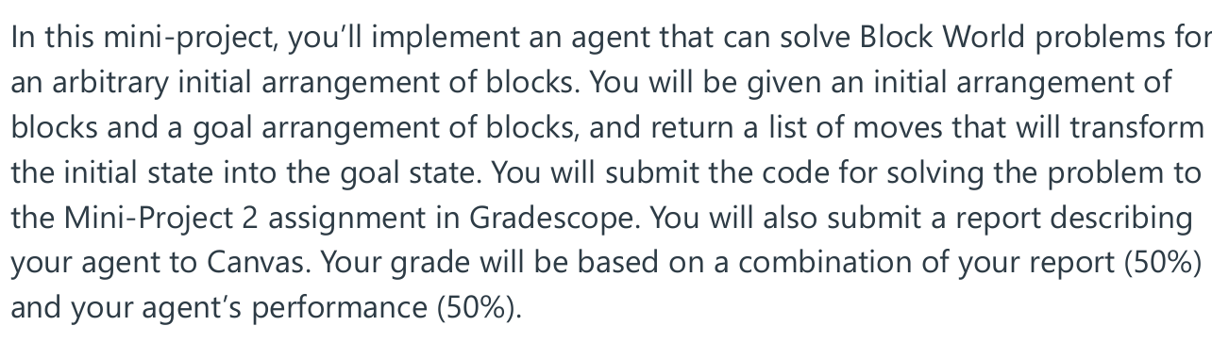




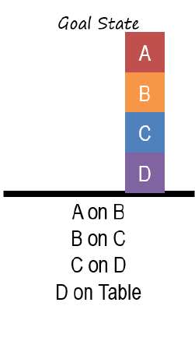
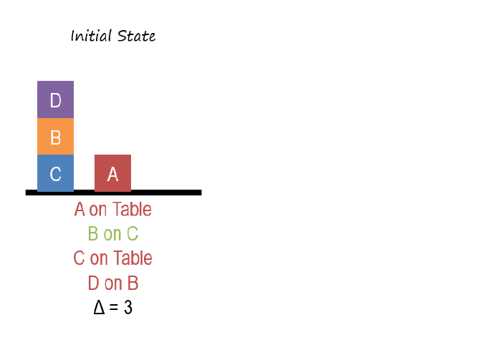

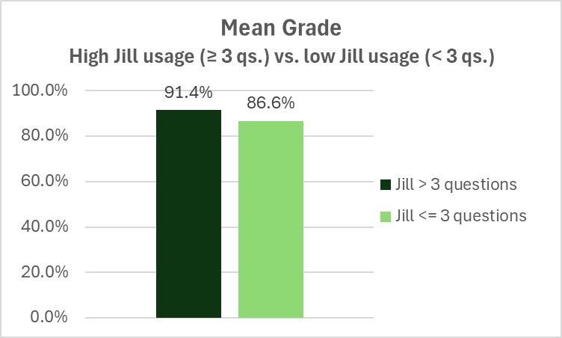
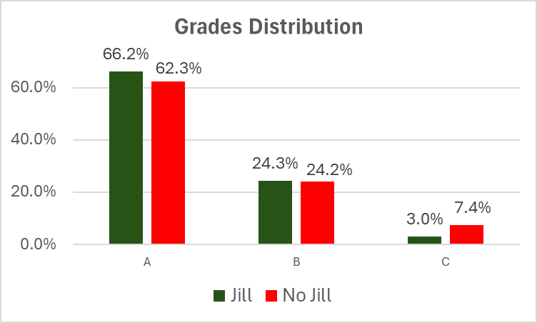
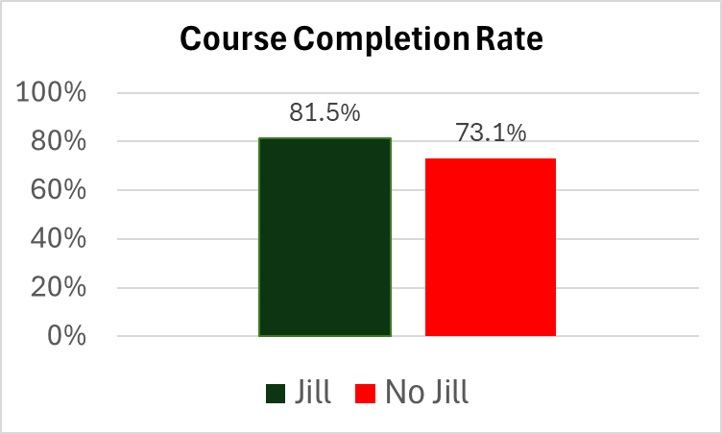



Jill Watson: Multi-Modal Virtual Teaching Assistant
Vishita Batra, Jizhou Chen, Cristina DeLisle, Sandeep Kakar, Isaac Lo, Maisha Mahmood, Pratyusha Maiti, Jan Ramos, Shay Samat, Karan Taneja, Qiuchen Wang, Ashok Goel
Design Intelligence Laboratory, School of Interactive Computing, Georgia Institute of Technology
Introduction
Architecture
Survey Results
Jill Watson (JW), first deployed in OMSCS classes in 2016, is a conversational agent that can answer questions based on instructor approved course material.
Objective: Jill Watson is rooted in the Community of Inquiry (CoI) framework, aiming to enhance adult learning and online education by specifically focusing on improving Teaching Presence in online classrooms.
Query Flow
Response Generation
Performance on Transfer Tasks: No significant difference between student scores with two systems.
Perception: MuDoC was significantly favored on all measures: Overall Experience (22/30), Content Exploration (28/30), Engagement (26/30), Memorability (23/30), Confidence (23/30), Trustworthiness (20/30)
Qualitative Feedback: Largely positive but MuDoC shows an overwhelming amount of information which lead to cognitive overload. There are many complex interactions between MuDoC features (multimodality, verifiability) and outcomes (engagement, trust, learning).
Object Storage
Knowledge Base
MuDoC
GPT-4o
search_texts(query)
search_images(query)
What is block world problem?
User Interface
QA Service
Embedding Model
search_texts/images(“block world problem”)
Student
Integrating Information
Document Flow
search_images(“block world problem”)
Engagement
Multimodality
Knowledge Base
{“results”: [“img…”, …]}
Image Grounding
Multimedia Learning
Object Storage
Learning/Retention
Verifiability
Interactivity
Cognitive Processing
Chat View
Document View
Deployments
Document
Pre-processing Service
{“results”: [“…”, …]}
Credibility
Trust
Instructor
Embedding Model
Bloom’s Taxonomy Analysis
Document
Block world problem is…
<img src =“…”>
- Reasoning
Knowledge
Comprehension
Application
Analysis
Evaluation
Synthesis
Technical College System of Georgia
Document Pre-processing
LO Increasing Complexity HO
OCR
Clean
Semester | Course / Institute | # Questions | %HO
Fall 2023 | KBAI/GT | 2311 | 50.3
 | ENGL/WG | 163 | 30.1
Spring 2024 | KBAI/GT | 1920 | 48.2
 | CogSci/GT | 332 | 22.6
 | ENGL/WG | 32 | 37.5
Summer 2024 | HCI/GT | 561 | 35.7
 | ENGL/SRTC | 235 | 26.4
Document Layout Analysis
Text Snippets
Raw Text
Summarize
(GPT-3)
Cleaned and Summarized Texts
A/B Test Results
PDF Documents
Caption
Describe
(GPT-4)
Layout with Bounding Boxes
Image Snippets
Image Captions and Descriptions
Scalability:
A microservice architecture allows each component to scale independently for high availability.
Multimodal Answers: Enhances student understanding by generating comprehensive answers that combine explanatory text with relevant visuals.
Source Attribution: Answers include precise citations to course material, enabling easy verification of grounded truth.
Literature: In traditional settings, only 10-20% of questions are categorized as HO questions.
Acknowledgement
This research is supported by the National Science Foundation under Cooperative Agreement DRL-2112532 with the National AI Institute for Adult Learning and Online Education (aialoe.org).

