Slide 1
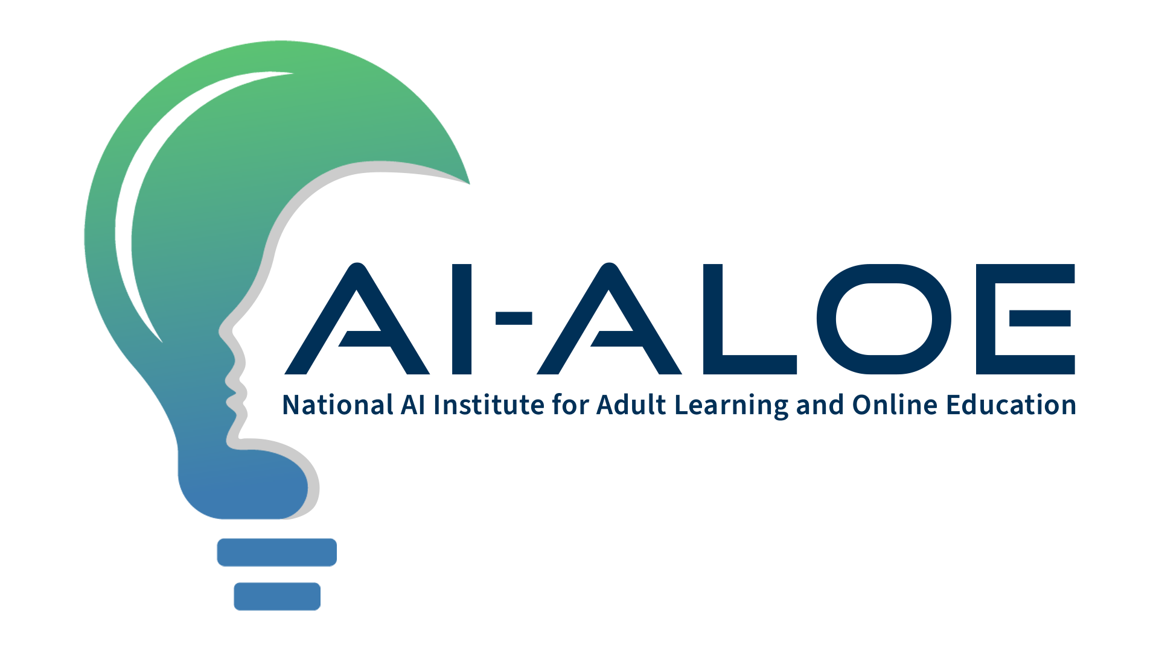

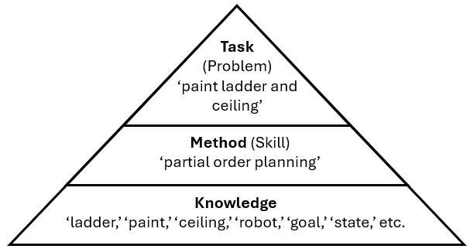
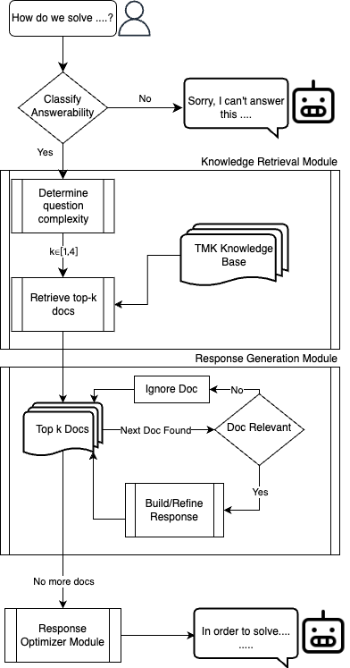
Ivy: A Hybrid Knowledge-based and Generative AI Coach for Explaining Procedural Skills
Rahul Dass, Zebing Li, Thomas Bowlin, Arpit Khandelwal, Xiao Jin, John Hall, Shubham Puri, Spencer Rugaber and Ashok Goel AI-ALOE @ Georgia Institute of Technology
Introduction & Motivation
Online learners often struggle to understand the “how” and “why” behind procedural skills.
Traditional chat-based agents offer shallow explanations that hinder skill-based learning
Proposal: A hybrid system combining knowledge-based AI and generative AI to generate explanations that embody teleological, causal and compositional principles.
Research Questions
RQ1: How can an intelligent agent (IA) explain how a skill functions?
RQ2: How can an IA inspect the design of a skill?
Model Skills using the TMK Framework¹
An IA can effectively explain how a skill functions if it is decomposed using the TMK (Task-Method-Knowledge) framework.
We modeled six skills taught in a graduate-level AI course² using the following procedures:
Task definition: Identify the goal of a skill.
Method specification: Outline the sequence of states and state transitions to accomplish the task.
Knowledge representation: Define objects, concepts, and their relationships within the environment.
Example Use Case
Skill: Partial Order Planning (POP)
Learner Question: "What is the goal of the painting task in POP?"
IA Response: "The goal is to achieve the end state where both the ladder and ceiling are painted, ensuring actions are sequenced to avoid conflicts (e.g., paint ceiling before ladder).”
Compared to baseline methods, Ivy generates responses capturing structured logic and teleological aspects to skill learning.
Evaluation and Results
Developer Perception Evaluation:
Ivy preferred in 82.14% of responses over RAG benchmark (53.57%)
Semantic Similarity (SBERT Scores):
Ivy: 0.82 (Avg.) vs. Expected Responses.
Automated Knowledge Trace Analysis:
Correct TMK file usage in 90% of queries.
83% of content sourced from relevant documents.
Key Takeaways
Ivy powered by TMK models and Generative AI, provides deeper and more structured explanations than traditional methods.
Learners benefit from teleological, causal, and compositional reasoning in explanations.
Enhanced understanding of procedural knowledge leads to improved skill-based learning outcomes.
Future Work
Automating TMK model creation to reduce development time.
Expanding to episodic knowledge queries.
Conducting real-world learner studies to validate practical impact.
Figure 1: High-level TMK model of the ‘Partial Order Planning’ skill, showing hierarchical problem decomposition.
Algorithm for Skill Learning Q&A
Step 1: Learner submits question.
Step 2: Coach moderates and determines if it cannot answer or routes question to Knowledge Retrieval module.
Step 3: Assess question complexity to determine the depth of response and fetches relevant TMK components.
Step 4: Response generation iteratively refines answers.
Step 5: Optimize the response to be clear and concise and send it as output to the learner.
References
Murdock, J. W., & Goel, A. K. (2008). Meta-case-based reasoning: self-improvement through self-understanding. Journal of Experimental & Theoretical Artificial Intelligence, 20(1), 1-36.
Knowledge-based AI course, Georgia Tech, OMSCS program.
This research is supported by the National Science Foundation under Cooperative Agreement DRL-2112532 with the National AI Institute for Adult Learning and Online Education (aialoe.org). Any findings and conclusions expressed in this material are those of the authors and do not necessarily reflect the views of the National Science Foundation. Foundation
Figure 2: Overall schematic of Ivy’s architecture

