Slide 1
A4L (Architecture for Learning)
Ploy Thajchayapong
Team: Vrinda Nandan, Harsh Sikka, Jared Gage, Michael Fryer, Hong Wen Tai, Matthew Patton, Gopal Kalyanaraman

Slide 2
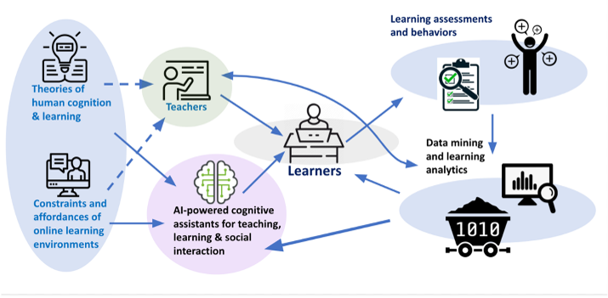
Analytics module
Aims to apply insights to tailor for teachers, learners and AI Agents
Notes:
This year our work at A4L has been focused on using our architecture for learning analytics specifically meso-learning where we combined data from different data sources across various AI technology
The aim of our A4L and meso learning analytics is to apply insights to tailor for teachers, learners and AI agents as Ashok mentioned earlier.

Slide 3
A4L Data store for Learning framework
Micro-learning
Meso-learning
Macro-learning
Requires data from ​
a single episode of​
a student interacting ​
with an AI tool​
Requires data from a class,​
multiple data sources,​
multiple episodes of interaction
Requires data across a program​ or programs, multiple tools
JW
iTELL
Canvas
JW + SAMI + VERA
iTELL across semesters
VERA
Apprentice Tutor
Demographics
SMART across a study program
SAMI
SMART
Survey
Apprentice Tutor across semester and study program
A4L Data store
Notes:
Here we show how A4L data store can support learning framework from micro to meso to macro learning
Data from each AI tool are stored systematically to make it available for micro-learning analysis
On top of data from each AI technology, external data such as student learning and performance from canvas, student demographic information and student survey are also available in the data store to be available for meso-learning analysis
We have been collecting data I was mentioning from cycle 1 to cycle 8 and these data could be used for macro learning analysis in the future

Slide 4
A4L – An end-to-end data platform
Integrated with the data engineering process
Designed with a focus on data privacy and security
Multiple data sources
ETL to improve data quality
A4L
An end-to-end data platform
Supports meso-learning
Supports longitudinal studies
Enable personalization at all learning scales
Integrated with analytics module and visualization capability
Notes:
A4L is an end to end data platform that is uniquely designed to focus on data privacy and security
The platform is integrated with the data engineering process that is to manage multiple data sources dealing with various kind of data formats as well as to provide ETL to improve data quality
It is also integrated with analytics module and visualization capability
Our platform aims to enable personalization at all learning scales. That is to support meso learning of learner's experience within a course and also support longitudinal studies across difference AI technology

Slide 5
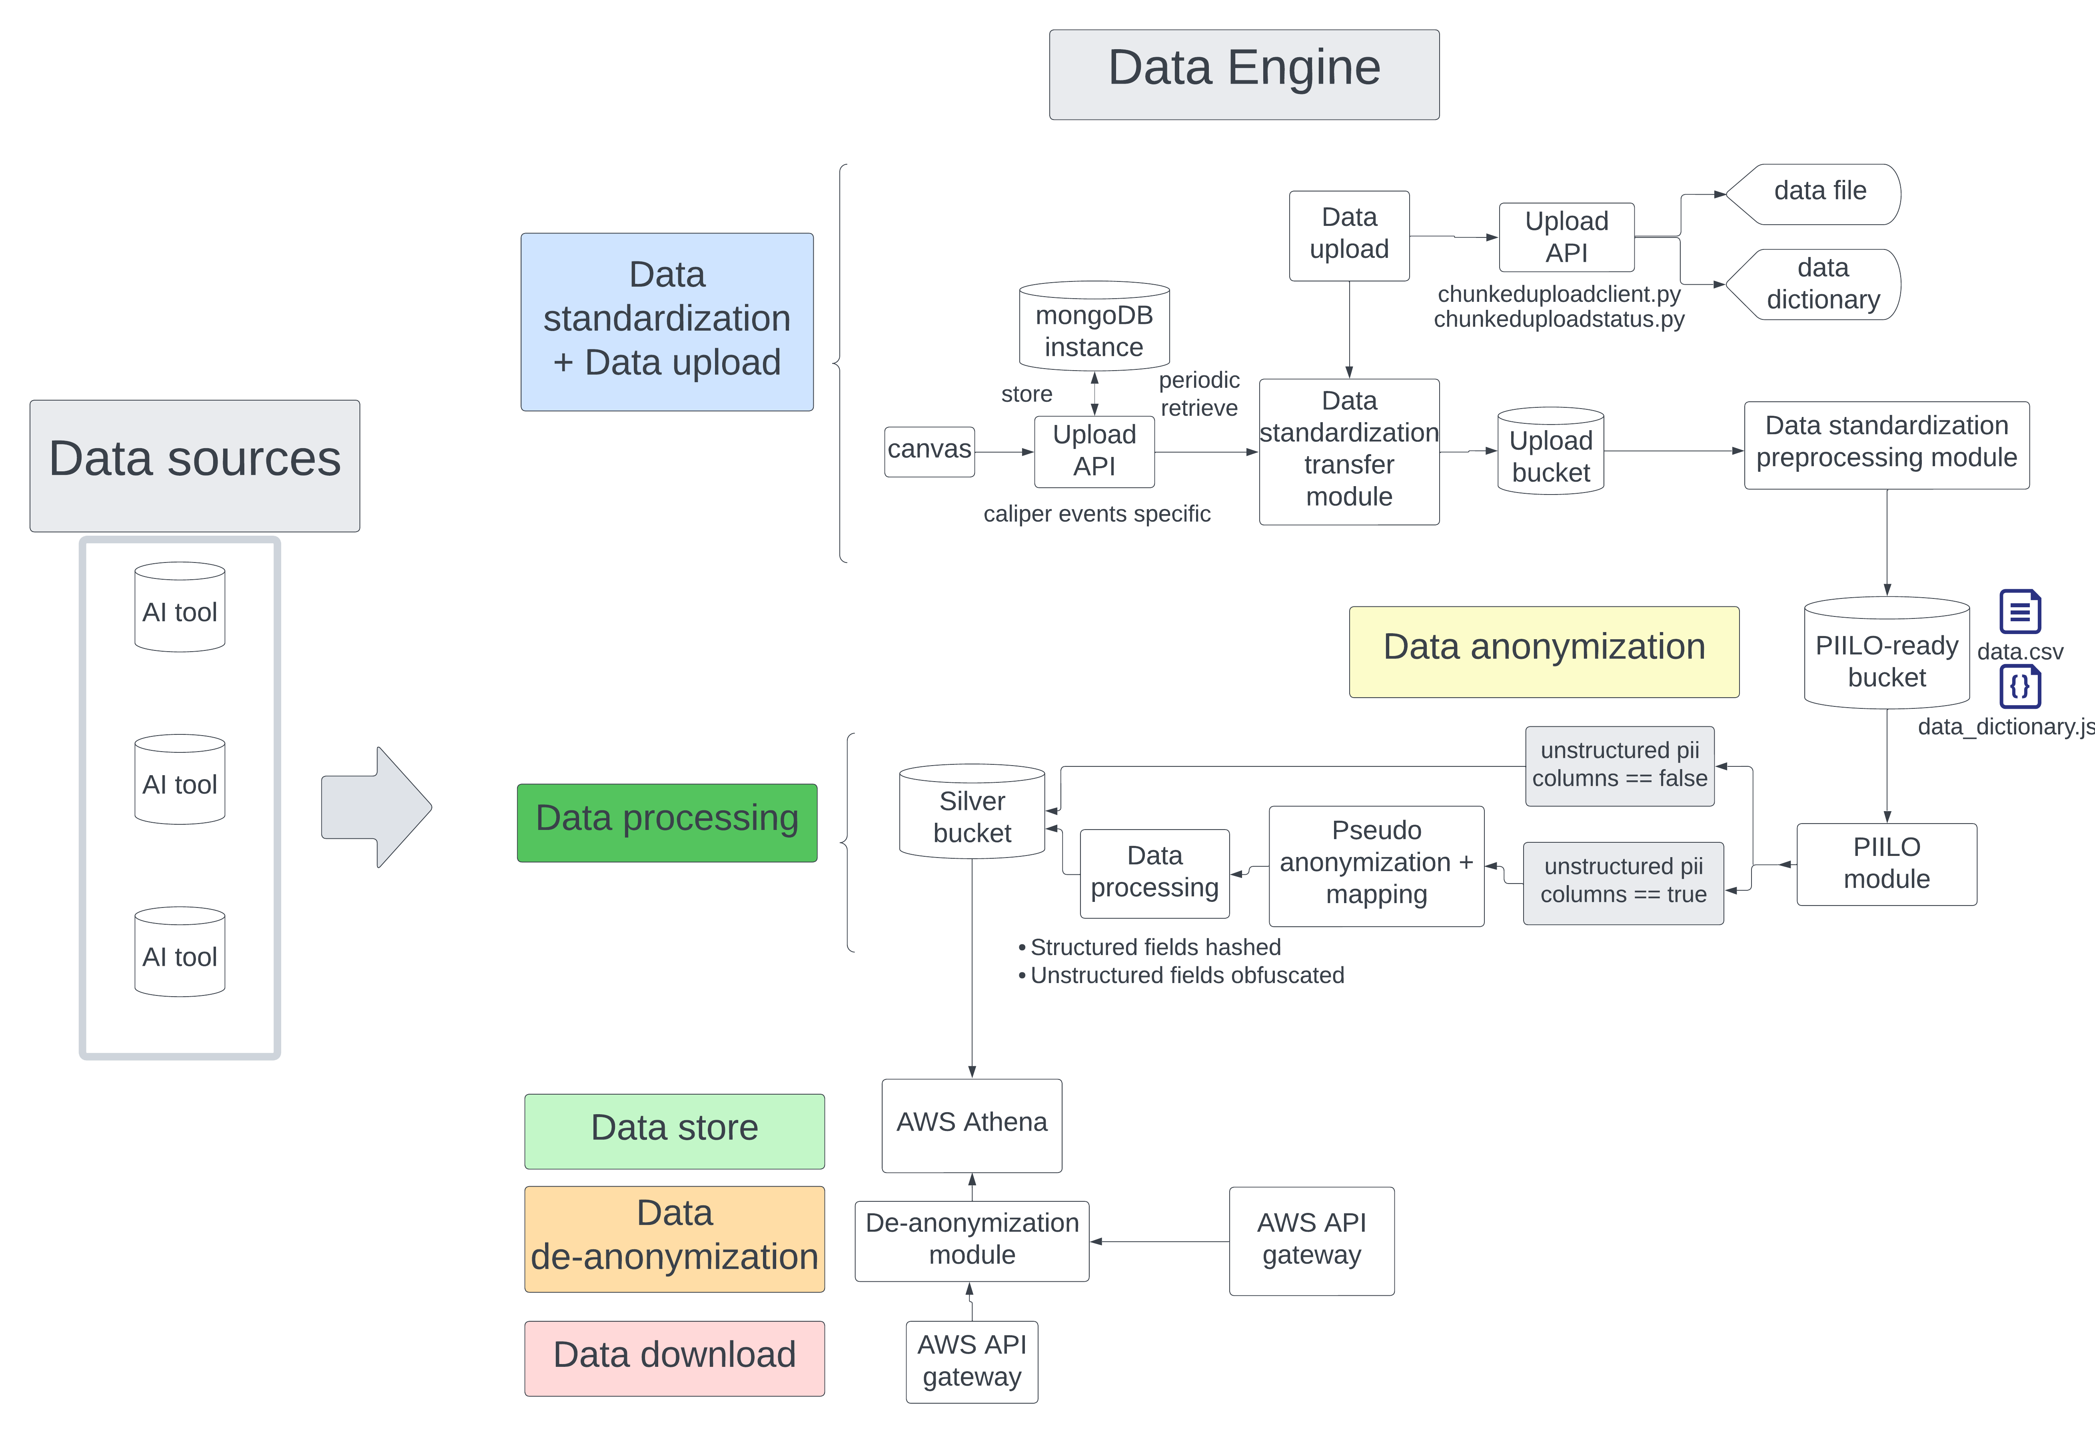
Overview Data Platform
Bronze
Testing for re-design needs
Data Engine v1.0
Ongoing
Silver
Data analytics
Data visualization
Personalization
Dashboard
Gold
Notes:
Here we show the high level of our architecture – there are 2 main components – data source and data engine. Within data engine, there are 6 components as labeled in the diagram.
First, data upload and data standardization. This is where we ingested the data from multiple sources into our bronze bucket. We have data upload interface that allows users to easily upload the data. Once data is uploaded, data is automatically pushed to our data anonymization module where sensitive information is masked and stored in the silver bucket
Data then is pushed to the data store. Users can download the data from here using our data download API as well as obtaining de-anonymized information when needed
Our data engine 1.0 has been tested and available to use
We are also in the process of building extended services – data analytics and personalization and data visualization and dashboard modules. These services are ongoing and will be used to test and re-design our data engine for improvement

Slide 6
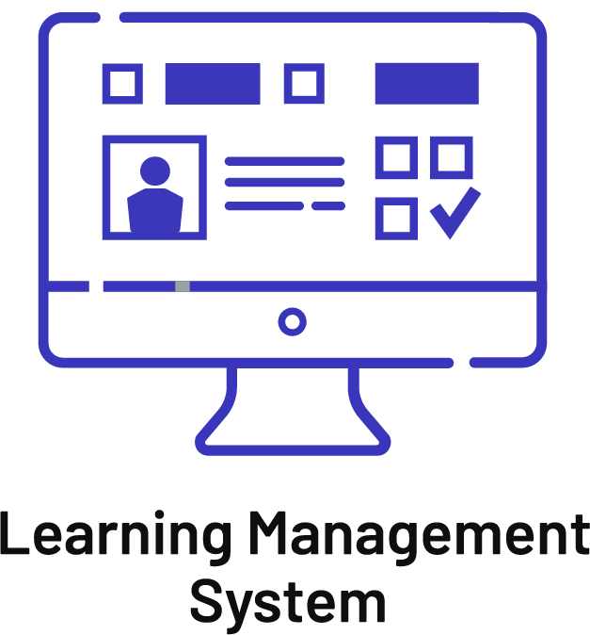
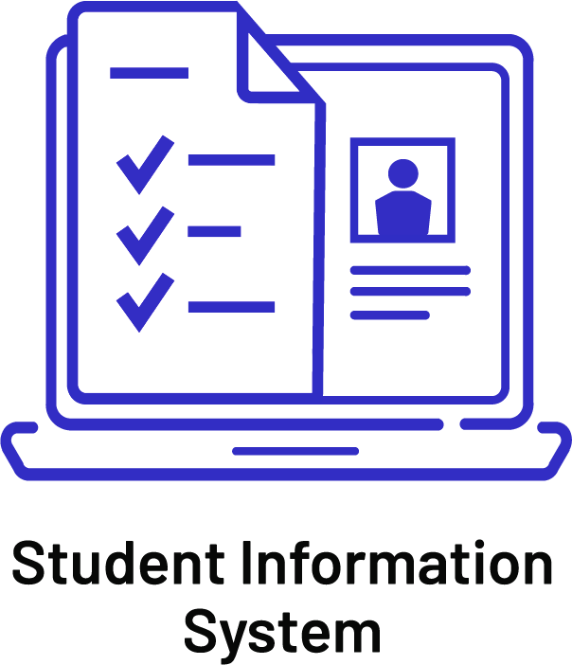
1EdTech collaboration
Edu-API: User, Demographics, Enrollment & Outcomes Data
Data Warehouse
User, enrollment, demographics, and outcomes data →
Edu-API
APPS:
SAMI
SMART
VERA
Apprentice Tutors
iTELL
Jill Watson
Caliper
Tool usage and context Data
SIS
LMS
LTI
Authentication & Context data
Edu-API
User Attributes and Enrollment Data →
← Grade passback
Notes:
A4L is collaborating with 1EdTech on redesigning the data engine to standardize data across various AI technologies, ensuring streamlined data access and security. The redesign will handle user, enrollment, demographics, and outcomes data using 1EdTech’s existing tools such as Edu-API and Caliper Analytics

Slide 7
How our platform is different
Current stage
Future stage
~ 40 classes
(~5 classes per cycle 1-8)
Large scale classes
Scalability
Large scale institutes
5 institutes
Data upload
Data anonymization
Data analytics
Ready to use
pipeline
Personalization
Data standardization
Data store
Data visualization
Data processing
Data download
Dashboard
Notes:
Now let’s talk about what makes our platform different
Our A4L platform is designed to be scalable and ready to use. At the current stage, we are using our pipeline for approximately 40 classes across cycle 1 (spring 2022) to cycle 8 (summer 2024) from 5 institutes.
The platform is equipped with the features as I mentioned in the previous slide.
In future stage, we are aiming to use our platform in many classes in many more institute with an add on of having the features such as data analytics, personalization, visualization and dashboard

Slide 8
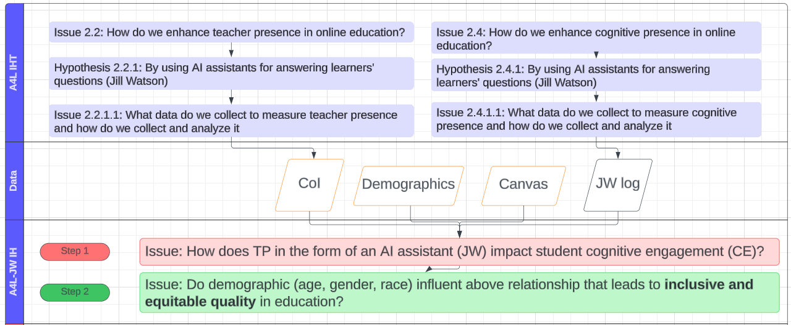
Our analytics work – The approach
Driven by Issue-Hypothesis Approach
Focused on Combined Data Sources
Hypothesis testing
Notes:
Like I mentioned earlier, the analytics work is ongoing. Here we show how we approach analytics –
Our work is driven by issue-hypothesis approach
We focused on combined data sources
Then we perform the hypothesis testing

Slide 9
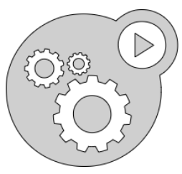
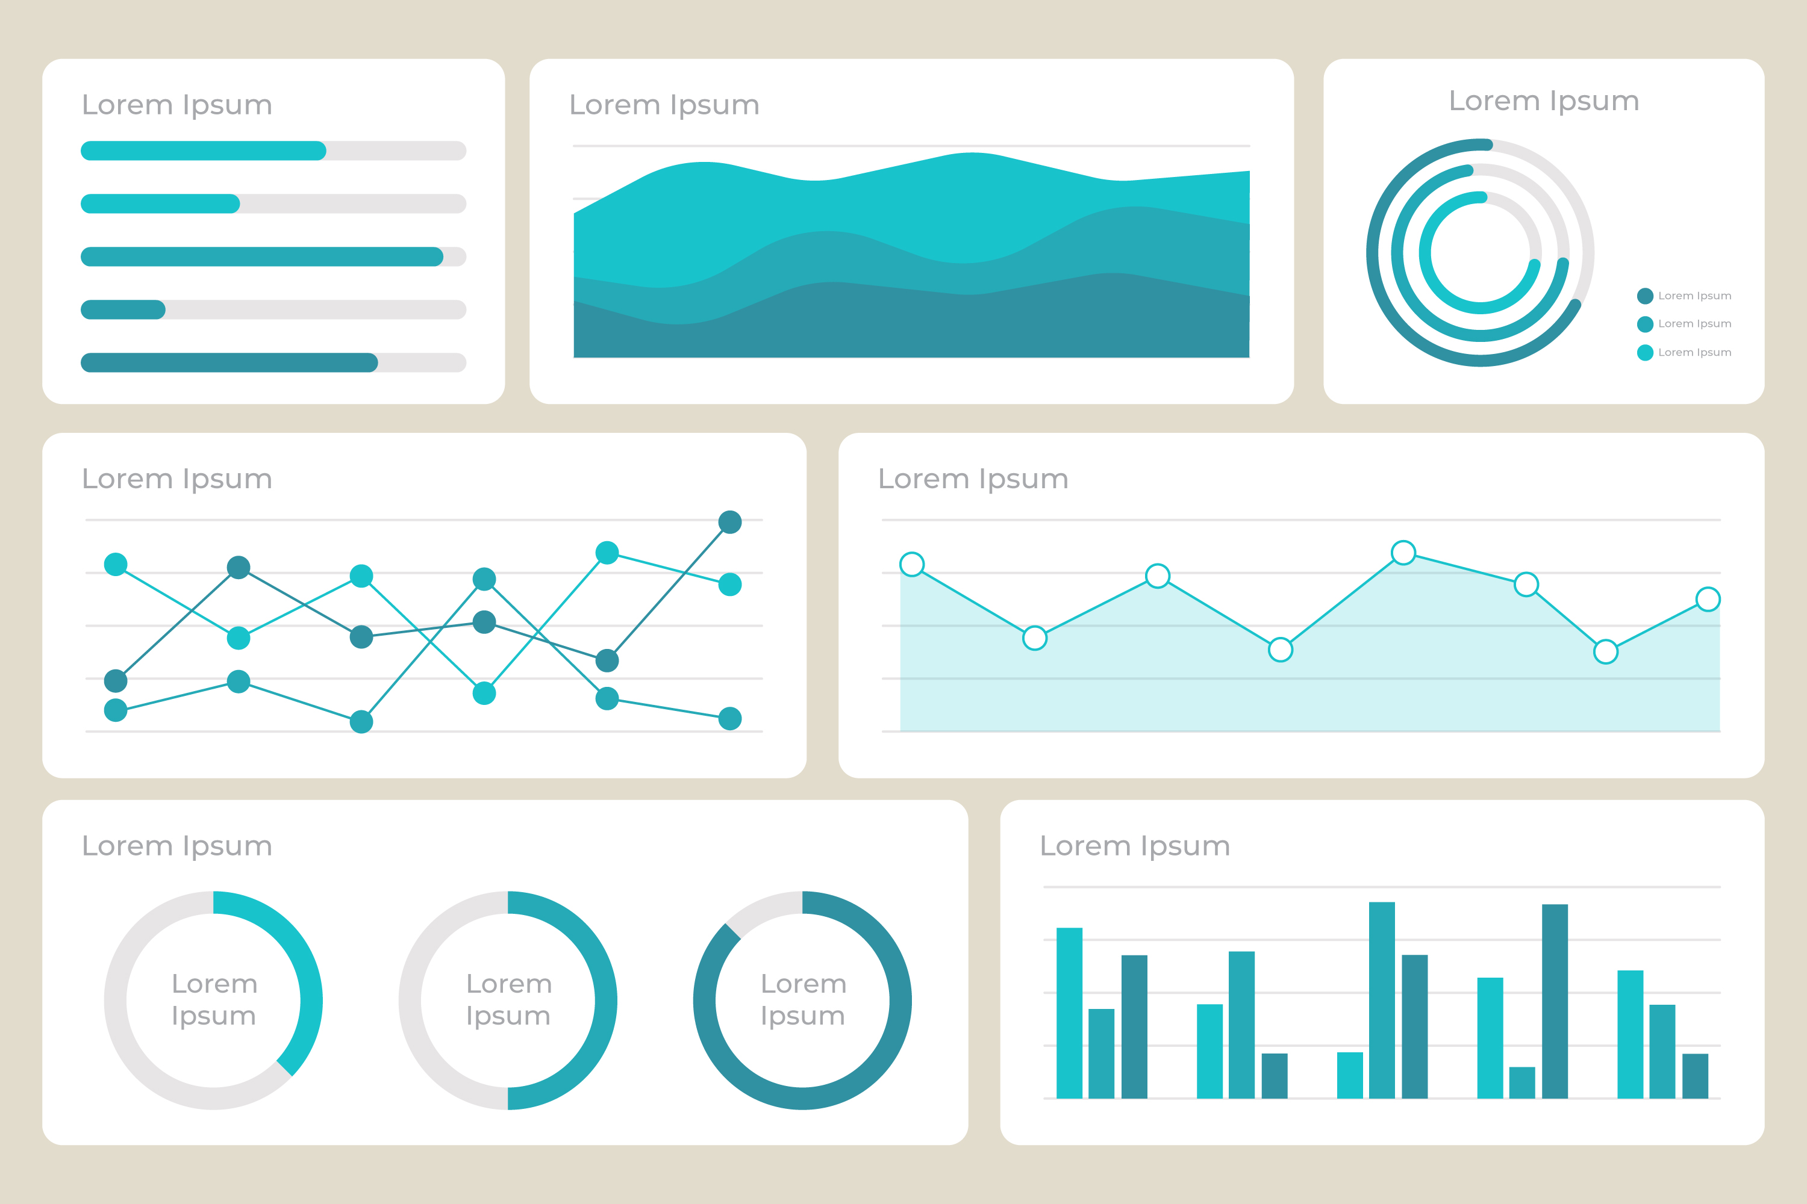
Next Steps
Data Engine
Meso-learning
Dashboard
Notes:
Now this brings us to our next steps beyond improving the data engine and performing meso learning analysis.
Here we show the high level process of our next step. The meso learning analytics will ingest the data from the data engine then produce the outputs that will be used to create the visualization and dashboard to support various types of users such as teachers, learners and researchers

