Slide 1
Modeling as a Skill (VERA)
Rahul Dass
20 June 2024
Team: Cathy Teng, Deci Lim, Dinesh Ayyappan, John Kos, Sareen Zhang, Shalini Sushri, Stephen Buckley, Spencer Rugaber & Ashok Goel

Slide 2
Motivations
Target customers: Adult learners pursuing careers in Ecology and Natural Resource management.
Issue: learners do not have deep understanding of "modeling as a skill"
Proposal: learn modeling through VERA!

Slide 3
"Modeling" Research Questions
RQ1: How can a learner develop “modeling” as a skill?
Hypothesis 1: Learner may learn model construction through inquiry-based learning
Hypothesis 2: Provide learners with personalized feedback using coaches.
RQ2: How can a learner get personalized feedback when learning modeling as a skill?
Hypothesis 1: An AI coach embedded in VERA can analyze a learner’s modeling behavior
Hypothesis 2: Based on the learner's behavior, the coach can provide adaptive metacognitive scaffolding as personalized modeling feedback.
Notes:
Inquiry-based learning ---> active learning, learning by doing, learning by reflection

Slide 4
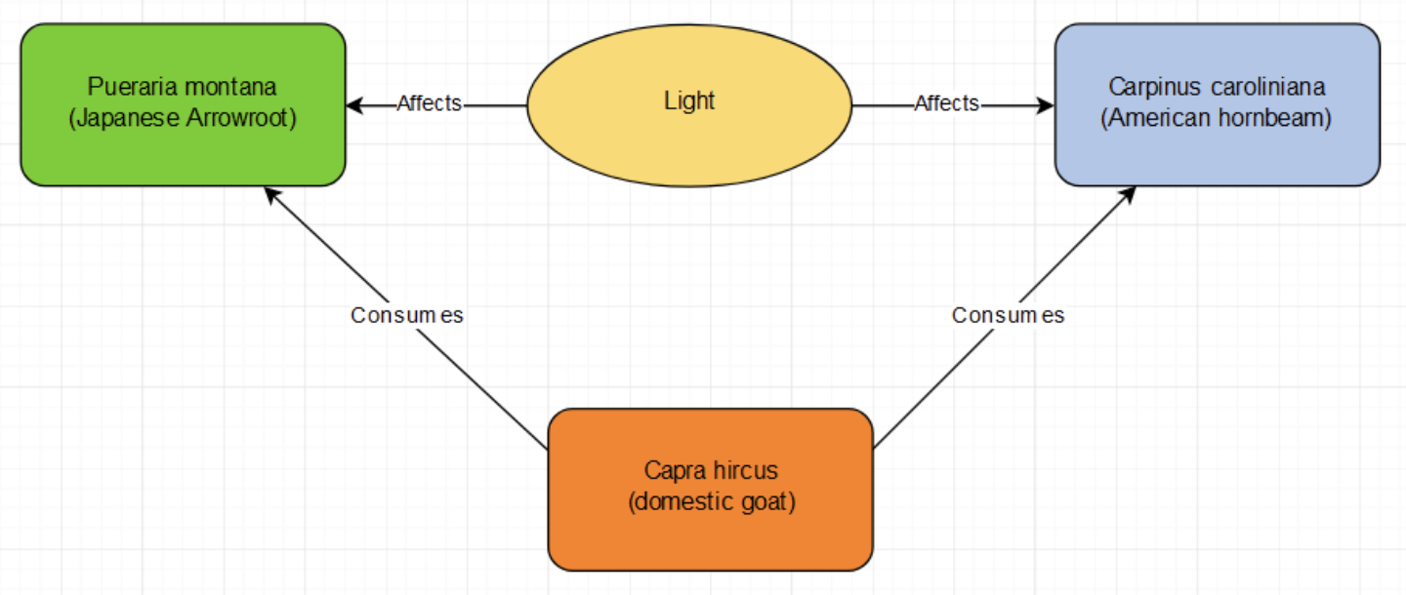
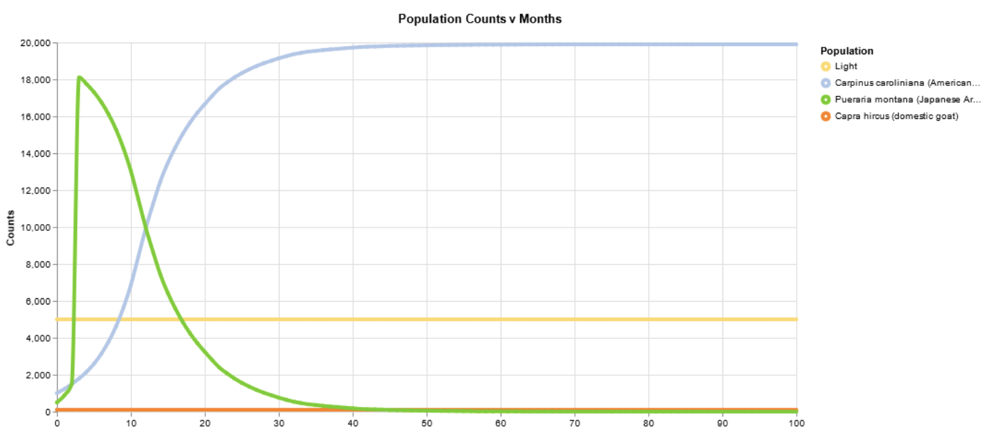
What is VERA?
Virtual Experimental Research Assistant
Virtual laboratory
Decompose modeling skills into three components:
Model construction
Model parameterization
Model simulation
Current domain: Ecology
Fig 1: VERA conceptual model
Fig 2: VERA simulation output

Slide 5
Theories of Learning
RQ1: How can a learner develop “modeling” as a skill?
Learners act as scientists
RQ2: How can a learner get personalized feedback when learning modeling as a skill?
Limitation: Personalization in open-domain problems
Proposal: Provide metacognitive feedback for ill-defined contexts (VanLehn 2013)
Investigation
Inquiry
Inquiry-based
Learning
Discovery
Construct new knowledge
Notes:
Issues with examples:
Bot depends on learners’ questions to give feedback; if cannot help if learner doesn’t know what they need help with.
MILA-T is rule-based. Learners cannot simply start modeling, they first need to write a definition of the phenomenon they are creating.

Slide 6
Theory of Change
Change => testable or measurable outcomes
Current domain knowledge & model metrics:
Attitudes towards scientific thinking & ecological modeling
Model variety and model complexity
Task completion: correctness and time taken
Notes:
Task completion correctness == did the student complete the assigned task

Slide 7
Exploration Coach Overview
Step 1: Classify a learner’s modeling behavior via clustering (An et al. 2022)
Constructors
Observers
Full-explorers
Step 2: Provide process feedback via adaptive metacognitive scaffolding
Learner | Feedback
Constructor | Parametric
Observer | Construction
Full-explorer | Motivational
Fig 2. PL feedback to learner
Notes:
By adaptive, feedback is based on the current state of the user’s model.
Step 1 classification via unsupervised learning
* Constructor – spends most time on constructing models; less time parameterizing or simulating models
* Observers – opposite of constructors; very little constructing
* full-explorers – full process of constructing, parameterizing and simulating models effectively

Slide 8
PL Coach Study: Experimental Design
Conducted A/B study in 2 classes @ Georgia Tech - Ecology Lab & Cognitive Science.
In each study, participants given 3 tasks:
Training task: tutorial on using VERA & stabilize ecological system.
Predator-prey task: stabilize a given predator-prey model.
Competitive-exclusion task: formulate a new ecology model
Study | Educational background | Control / Treatment | Students per condition | Working conditions
Ecology Lab | Undergrad; Ecology | No coach / Coach | 20 | Individual; 3-hour session
Intro. to Cog Sci | Graduate; CS | No coach / Coach | 35 | Groups; Untimed

Slide 9
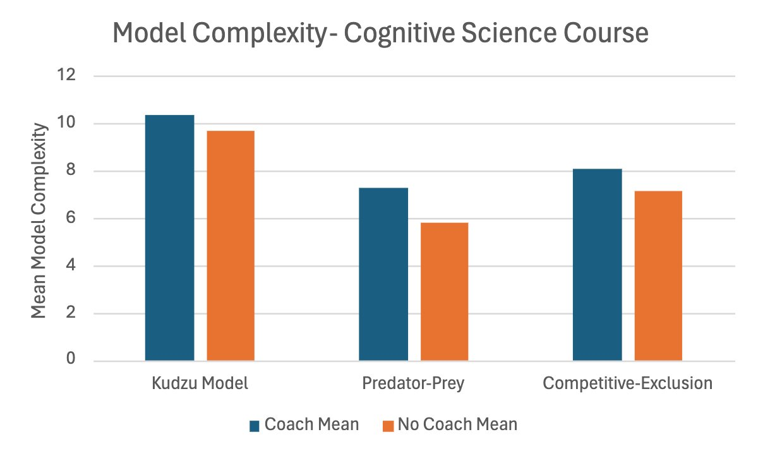
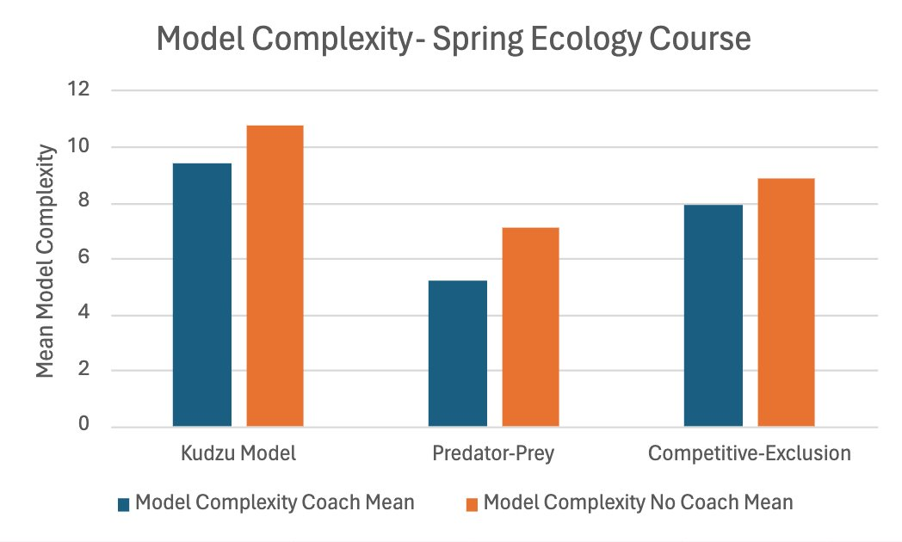
PL Coach Study: Initial results
Control group created more complex models than treatment group.
“constructors” found feedback more helpful than “full-explorers”
Fig 1. Comparing model complexities between EcoLab vs. CogSci VERA deployments, Spring 2024

Slide 10
Next steps
Data analysis:
Modeling as a skill study (NGTC)
Explore three new PL coaches:
Proactive vs. Reactive – feedback based on implicit vs. explicit request
Process vs. Product – feedback based on model itself vs. user activity
Single-episode vs. Multi-episode – feedback based on current session vs. past sessions
Notes:
Proactive vs. Reactive – feedback based on implicit vs. explicity request
Process vs. Product – feedback based on model itself vs. user activity
Single episode vs. multi-episode – feedback based on a single user session or considers user’s actions in prior sessions

